Slide 1
Course : Computational Biology
Effective Period : June 2022
Advances in
Computational Biology

Slide 2
Learning Objectives
History of Bioinformatics
Bioinformatics Application
Analyses Involving Nucleic-Acid Sequence
Additional Bioinformatic Analyses Involving Protein Sequences

Slide 3
What is Bioinformatics?
The mathematical, statistical, and computing methods that aim to solve biological problems using DNA and amino acids sequences, and related information
Before it was coined in 1991 scientists used to call it computational biology which basically explain the use of computer technologies to solve biological problems.
since bioinformatics is now defined with
a loose definition it always has the components of mathematics, statistics and computing method to process biological database
Biology has traditionally been an observational rather than a deductive science.
Although recent developments have not altered this basic orientation, the nature of the data has changed radically.

Slide 4
Introduction: What is bioinformatics?
Can be defined as the body of tools, algorithms needed to handle large
and complex biological information.
Bioinformatics is a new scientific discipline created from the interaction
of biology and computer.
The NCBI defines bioinformatics as:
"Bioinformatics is the field of science in which biology, computer
science, and information technology merge into a single discipline”

Slide 5
Bioinformatics Milestone
1951
Pauling and Corey propose the structure for the alpha helix
Watson and Crick propose the double helix model for DNA basd on x-ray data obtained by Franklin and Wilkins
The sequence of the first protein, bovine insulin, announced by F. Sanger
Margaret Dayhoff starts the Atlas of Protein Sequence and Structure – Dayhoff Atlas
Protein Sequence Database (PSD) by Margaret Dayhoff
1953
1955
1965
1972

Slide 6
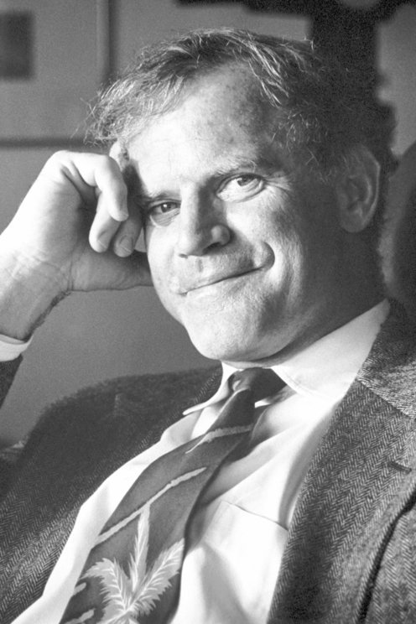
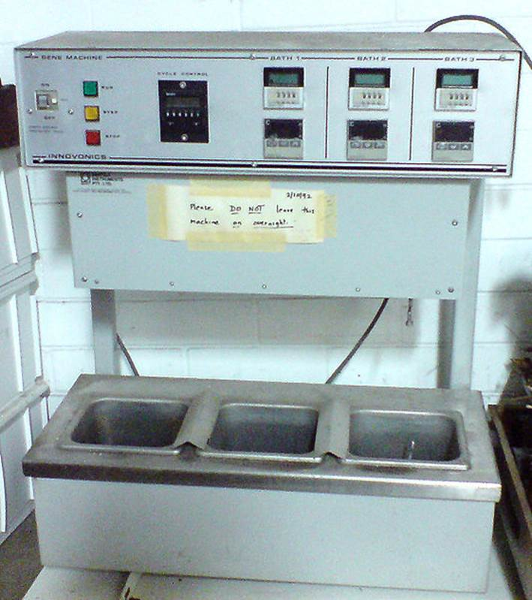
Bioinformatics Milestone
1977
Stanley Cohen Invented DNA Cloning
Sanger et al. invented cycle sequencing
The 1st complete gene sequence for bacteriophage FX174 is published (5,386bp, 9 proteins)
IBM Introduce Personal Computers and the Smith-Waterman algorithm for sequence alignment in published
The Polymerase Chain Reaction is described by Kary Mullis
Creation of the public GenBank
1980
1983
1981
1985

Slide 7


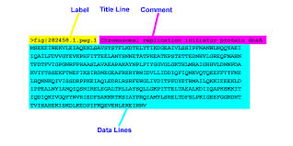
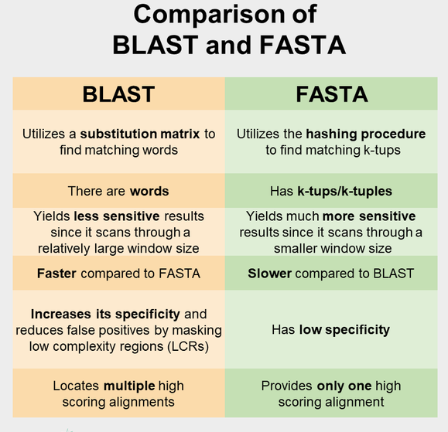
Bioinformatics Milestone
Practical Extraction Report Language is released by Larry Wall. Perl is used to analyze biological their assets apart from Python programming language.
The National Center for Biotechnology Information (NCBI) is established
The FASTA algorithm for sequence comparison is published by Pearson & Lipman
BLAST program is implemented
The first reference to the word “bioinformatics” in the scientific literature
1987
1987
1988
1990
1991

Slide 8
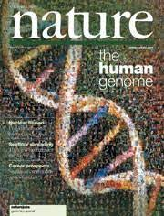
Bioinformatics Milestone
1998
The Institute for Genomic Research (TIGR) is established by Dr. Craig Venter
Dr. Craig Venter forms Celera in Rockville
A draft of the human genome
(3,000 Mbp) is published
Completion of Human Genome Project
Identify all the approximately 20,000-25,000 genes in human DNA
Determine the seunce of the 3 billion base pairs that make
Store this information in databases
Improve tools ofr data analysis
Transfer related technologies to the private sector
Address the ethical, legal, and social issues (ELSI) that may arise from the project
2001
2003

Slide 9
Bioinformatics and System Biology
This has led to the development those studies on three different aspects of life sciences which are Genomics, Proteomics, and Metabolomics makes the integration of all these aspects is well known to be a System Biology
Genomics
Studies of the genetic make-up of organisms
Proteomic
Studies of the structure and function of proteins. What they do, what they interact with, and how they contribute to life processes
Metabolomics
Comprehensive and simultaneous studies of metabolites at the systemic levels and their changes over time as consequences of stimuli

Slide 10
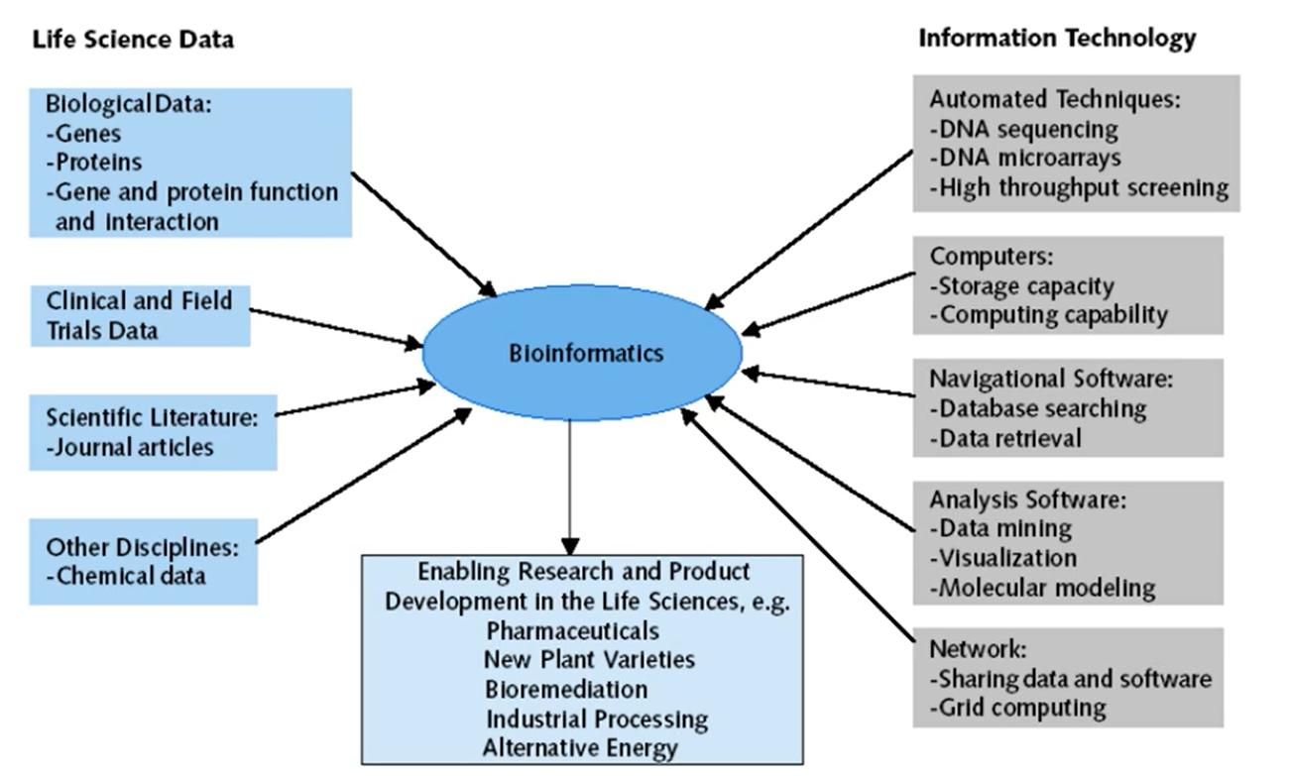
Bioinformatics Discipline

Slide 11
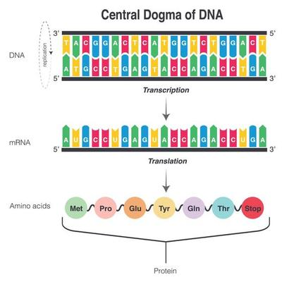
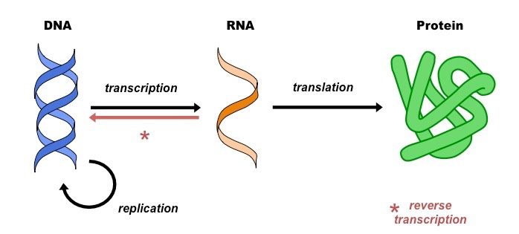
Central Dogma
The central dogma of molecular biology is an explanation of the flow of genetic information within a biological system. It is often stated as "DNA makes RNA, and RNA makes protein", It was first stated by Francis Crick in 1957, then published in 1958
3 Process of central dogma
From existing DNA to make new DNA (replication)
From DNA to make new RNA (transcription)
From RNA to make new proteins (translation).
This process of genetics information flowing from
DNA to RNA to Protein is called gene expression.

Slide 12
Analyses Involving Nucleic-Acid Sequence
DNA sequencing provides information about genes and genomes:
DNA sequencing uses chain-terminating reagents to identify the order of fragments and from this to infer the sequence of bases
Restriction fragment length polymorphisms (RFLPs) identified by Southern blotting reveal individual differences in DNA.
DNA fingerprinting uses probes to locate polymorphic DNA fragments.

Slide 13
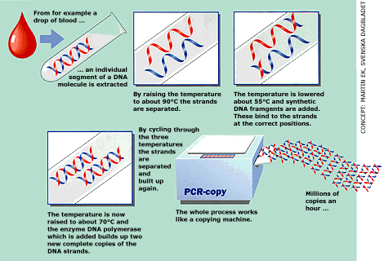
DNA ANALYSIS
The polymerase chain reaction accelerates the process of analysis:
The polymerase chain reaction (PCR) amplifies a single small DNA fragment using two short primers that flank the region to be amplified.
Cyclic replication is accomplished via heating and cooling; a key factor is Taq polymerase, which is not denatured at high temperature.
Protein interactions can be detected with the two-hybrid system:
The yeast two-hybrid system relies on fusion proteins and a reporter gene to study protein–protein interactions

Slide 14
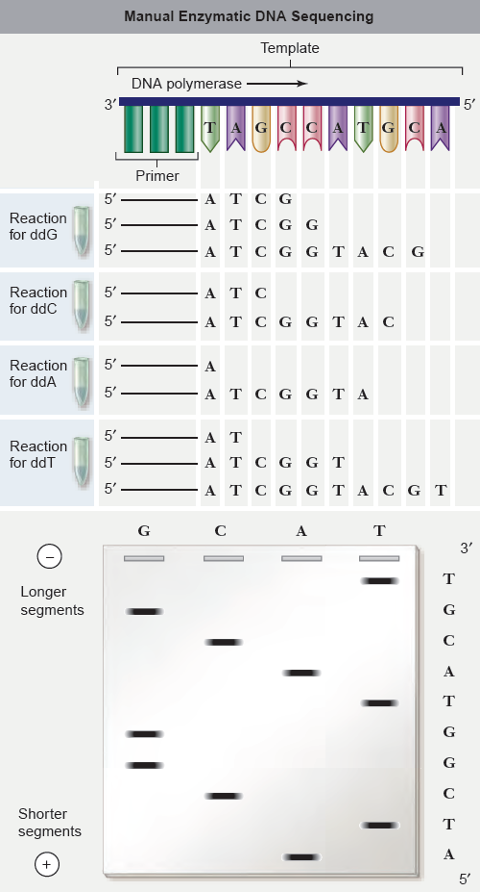
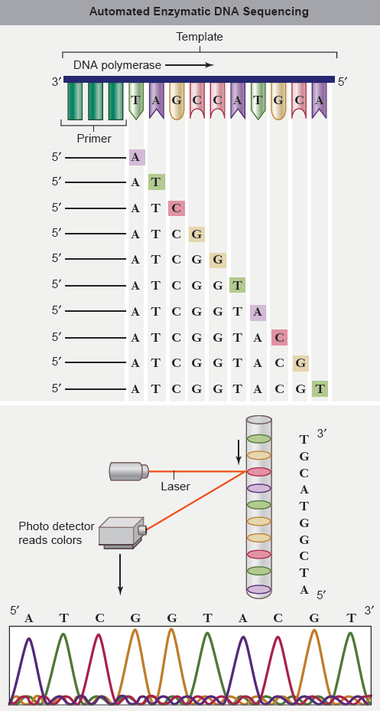
Manual and automated enzymatic DNA sequencing

Slide 15
GENETIC ENGINEERING
Expression vectors allow production of specific gene products:
Expression vectors contain the promoters and enhancers necessary to drive expression of the inserted DNA.
Genes can be introduced across species barriers:
Transgenic organisms can be constructed to express genes in a different species or to create mutations in genes to assess phenotype.

Slide 16
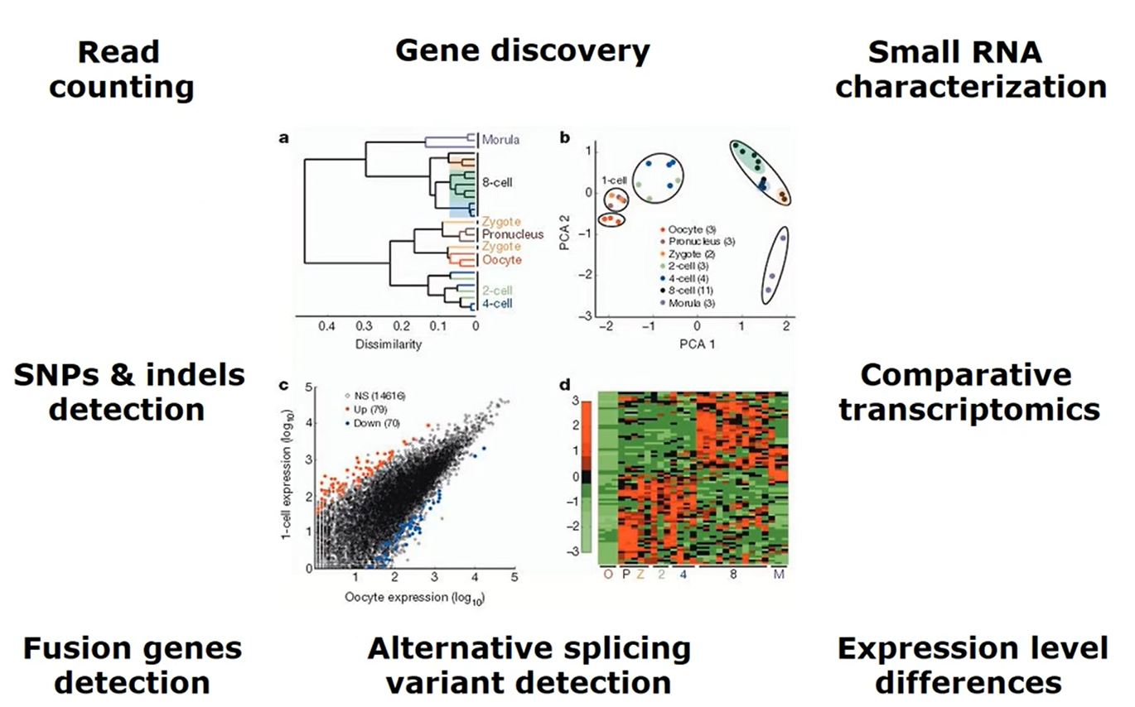
Bioinformatics Application
the application by informatics closely related to the analysis of large biological datasets these data sets are normally in the form of sequencing data

Slide 17
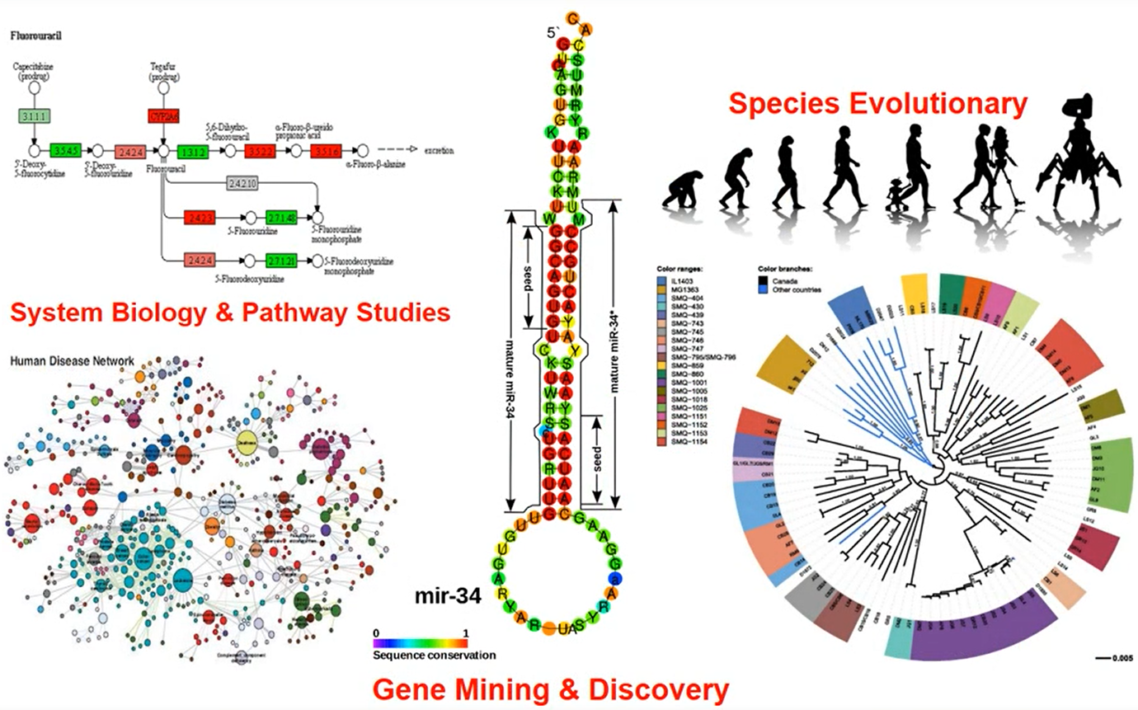
Bioinformatics Application
Most people will use by informatics to discover something novel by combining different types of bioinformatics methods and databases. Some, however, use bioinformatics to perform routine analysis for example disease diagnosis or microbial species identification.

Slide 18
Biological data types and analysis objectives
Genomics
  Nucleotide genome sequences, metagenomic sequences
  Gene finding, functional annotation, sequence alignment, homology determination, comparative analysis, phylogenetic inferencing, association analysis, mutation functional prediction, species distribution analysis
Transcriptomics
  RNA expression levels, transcription factor binding, chromatin structure information
  Differential expression, clustering, functional enrichment, transcriptional regulation/causal reasoning
Proteomics
  Proteins levels, protein structures, protein interactions
  Protein identification, protein functional predictions, structural predictions, structural comparison, molecular dynamic simulation, mutation functional prediction, docking predictions, network analysis
Metabolomics
  Metabolite/small molecule levels
  Pathway/network analysis
Imaging
  Microscopy images, MRI images, CT scans
  Feature extraction, high content screening
Cytometry
  Cell levels, cell phenotypes
  Cell population clustering, cell biomarker discovery
Systems biology
  All of the above
  Network analysis, causal reasoning, reverse causal reasoning, drug target prediction, regulatory network analysis, information flow, population dynamics, modeling and simulation

Slide 19
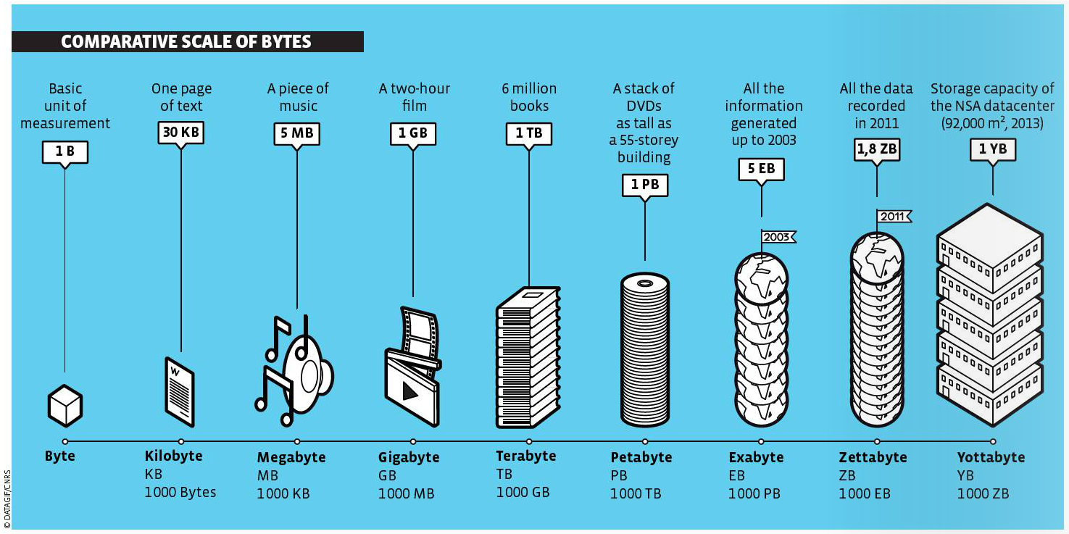
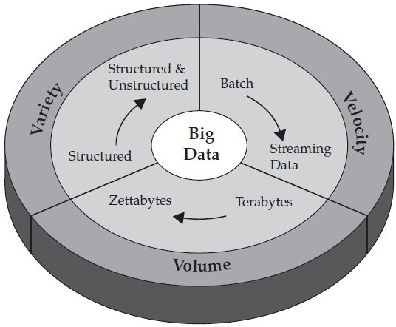
Big Data in BioInformatics
Big data describes a large volume of data, in bioinformatics and computational biology, it represents a new paradigm that transforms the studies to a large-scale research.
The high-throughput experiments in bioinformatics, and increasing trends of developing personalized medicines, etc., increasing a need to produce, store, and analyze these massive datasets in a manageable time. The role of big data in bioinformatics is to provide repositories of data, better computing facilities, and data manipulation tools to analyze data
Faiza, M., 2016. Big Data in Bioinformatics, 2(3):page 14-18. The article is available at https://bioinformaticsreview.com/20160313/big-data-in-bioinformatics/

Slide 20
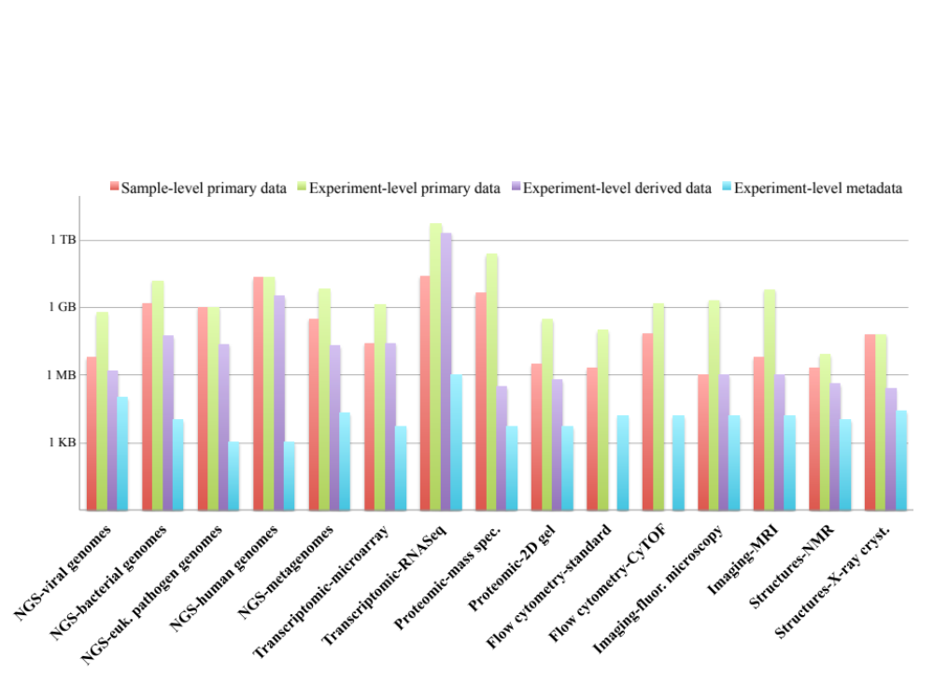
Big Data in Bioinformatics

Slide 21
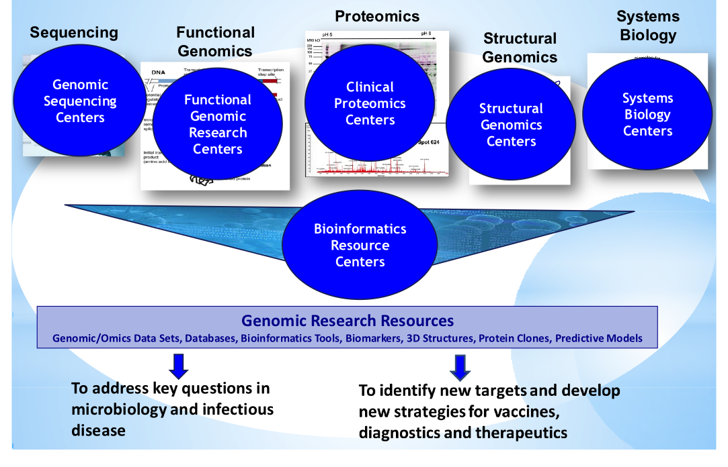
Current Bioinformatics Digital Resouces
Basic Bioinformatics Services:
SSS (Sequence Search Services),
MSA (Multiple Sequence Alignment), and
BSA (Biological Sequence Analysis).
Courtesy of Alison Yao, DMID

Slide 22
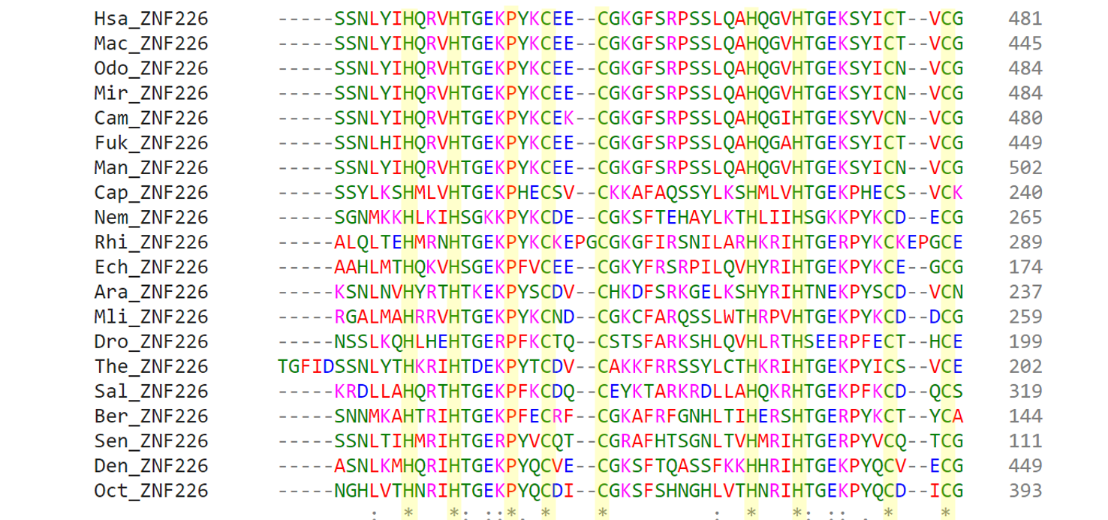
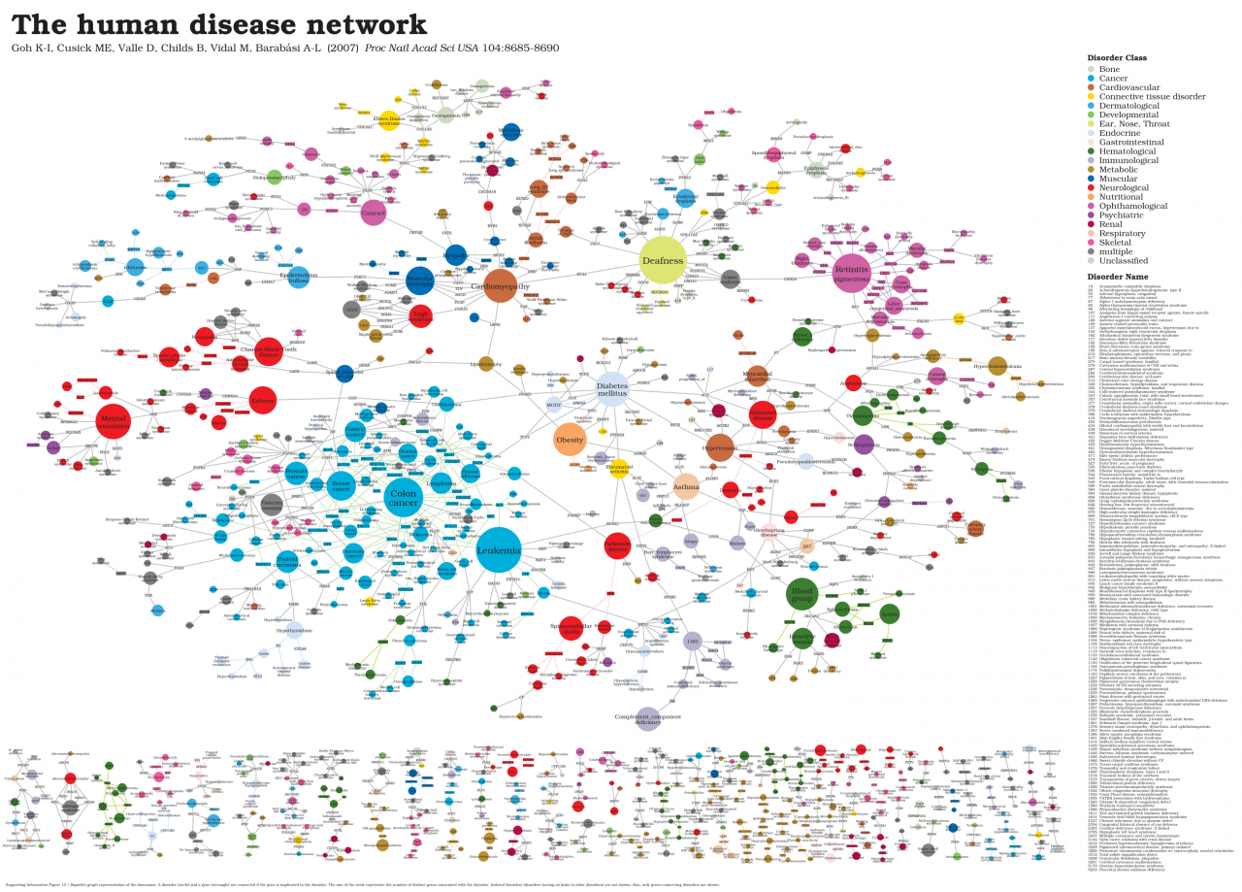
Main Bioinformatics Challenges for us
How do I make sense of my data?
Computational Challenges in Sequence Analysis

Slide 23
References
Lesk, Arthur M.. (2014). Introduction to Bioinformatics. 4. Oxford University Press, United Kingdom. ISBN: 978-0199651566. (*)
Choudhuri, S.. (2014) Bioinformatics for Beginners: Genes, Genomes, Molecular Evolution, Databases and Analytical Tools. Elsevier. ISBN 978-0124104716.
Simon, E. J.. (2020). Biology : The Core. 3rd Edition. Pearson: Hoboken, NJ. ISBN 9780134891514

